Slide 1
Whitmore TAA Portfolio
Kavin Ravi, Adler Wright

Slide 2
Summary & IPS Constraints
We recommend adopting the proposed SAA as the baseline portfolio, with a market stress TAA overlay
The TAA overlay improved annualized return from 8.50% to 9.49% while reducing the volatility from 10.41% to 9.13%
The overlay improved max drawdown from -30.54% to -19.05%
The TAA satisfies all three IPS targets of 8% return, ≤15% volatility, and ≤25% max drawdown
All allocations are subject to IPS constraints and include transaction costs

Slide 3
SAA Construction
The SAA was constructed using Markowitz Mean-Variance Optimization with Black-Litterman return estimates
This was chosen because Whitmore’s objective is not just minimizing risk, but balancing return generation with the stated IPS volatility and drawdown limits
Black-Litterman helped stabilize expected return inputs and reduce sensitivity to noisy historical return estimates
The SAA outperformed the traditional 60/40 benchmark and the diversified policy benchmark, but breached the IPS drawdown constraint

Slide 4
TAA Signal & Hypothesis
We designed a market stress TAA signal to identify risk-off regimes
Signal inputs: High Yield OAS, VIX, S&P 500 trend, and Russell 2000 / S&P 500 relative performance
Hypothesis: When credit spreads widen, volatility rises, equity trend weakens, and small caps underperform, expected returns on risky sleeves fall as downside risk increases
When triggered, the optimizer dynamically shifts away from risky sleeves towards more defensive sleeves to improve risk-adjusted returns and reduce drawdowns

Slide 5
Data & Walk-Forward Methodology
All data was procured from the Zion database and manually from the Bloomberg terminals
Asset classes used were: US Equities, Treasuries, TIPS, REITS, Gold, Bitcoin, and JPY for risk-off TAA signal fire
Assets were added into the universe as soon as their data began
12-fold walk forward strategy, 60-month expanding train window, 12-month val, 18-month test period
XGBoost fitted on training data as signal classifier, LSTM/Transformer fitted on train data for return forecasts

Slide 6
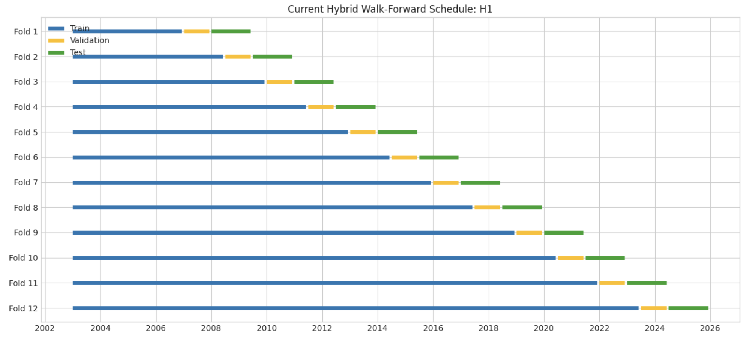
Walk Forward Cont’d
12 folds and rigorous data leakage protection was used to prevent “reward hacking” by the model
Models NEVER fit to val/test data

Slide 7
Trial Disclosure
Grid search run across 4 hypotheses
For each hypothesis, both LSTM & Transformer are tested
For each model, a variety of asset distributions and hyperparameters are tested
This leads to a massive parameter search space exacerbated by model training times
Solution: Autoresearch
All model/hyperparameter combinations are saved to avoid data snooping bias
For additional security against data snooping/cherrypicking, 2 bootstrap Monte-Carlo search simulations were run

Slide 8
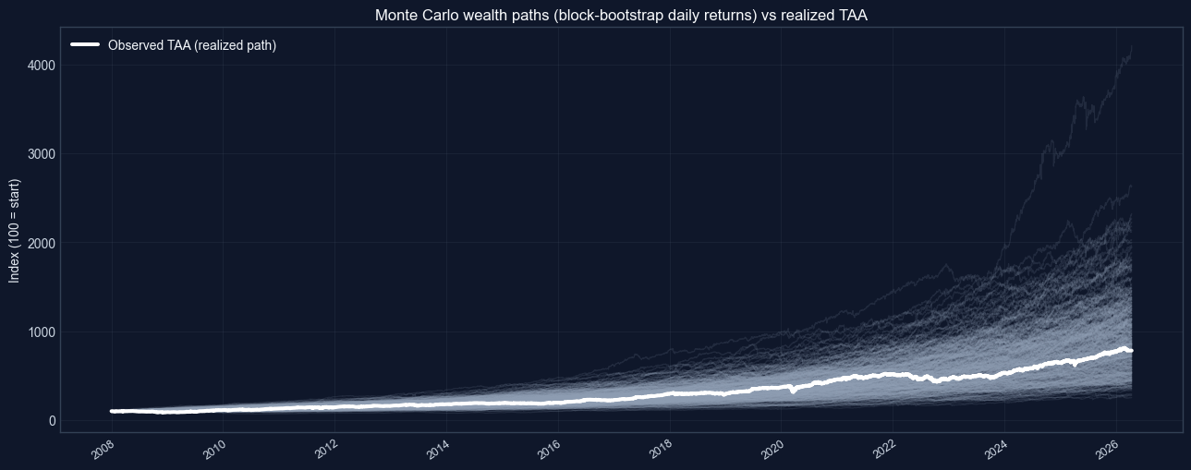
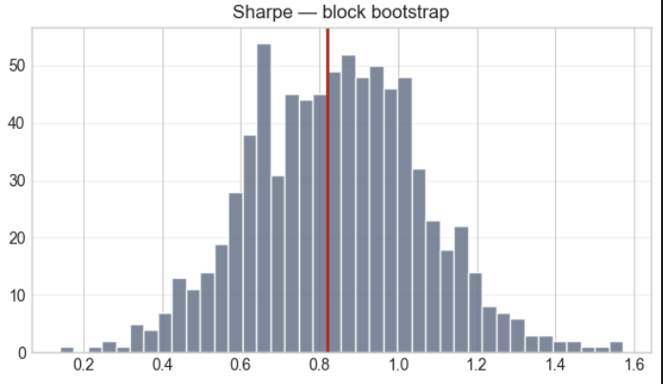
Trial Disclosure Cont’d
The left-side simulation is a random walk simulation including 500 random walks, proving that our portfolio is actually slightly unlucky
The right-side simulation tells a similar story, with Sharpe being perfectly average

Slide 9
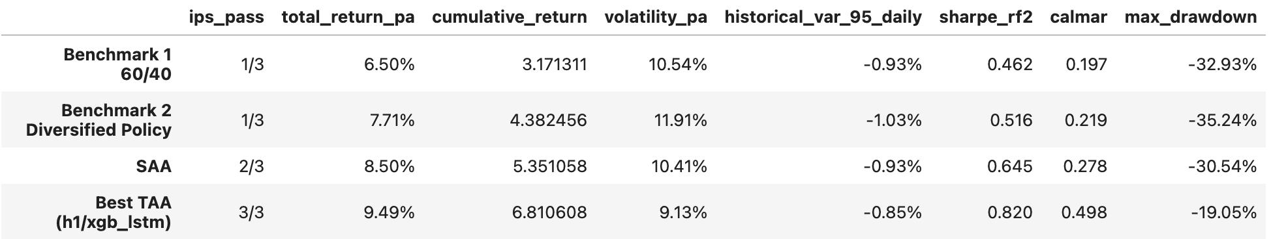
Performance
The SAA improved on both benchmarks, but breached the drawdown limit
The TAA overlay was the only portfolio to pass all three IPS targets
TAA improved return while also reducing volatility and drawdown, resulting in stronger risk-adjusted performance

Slide 10
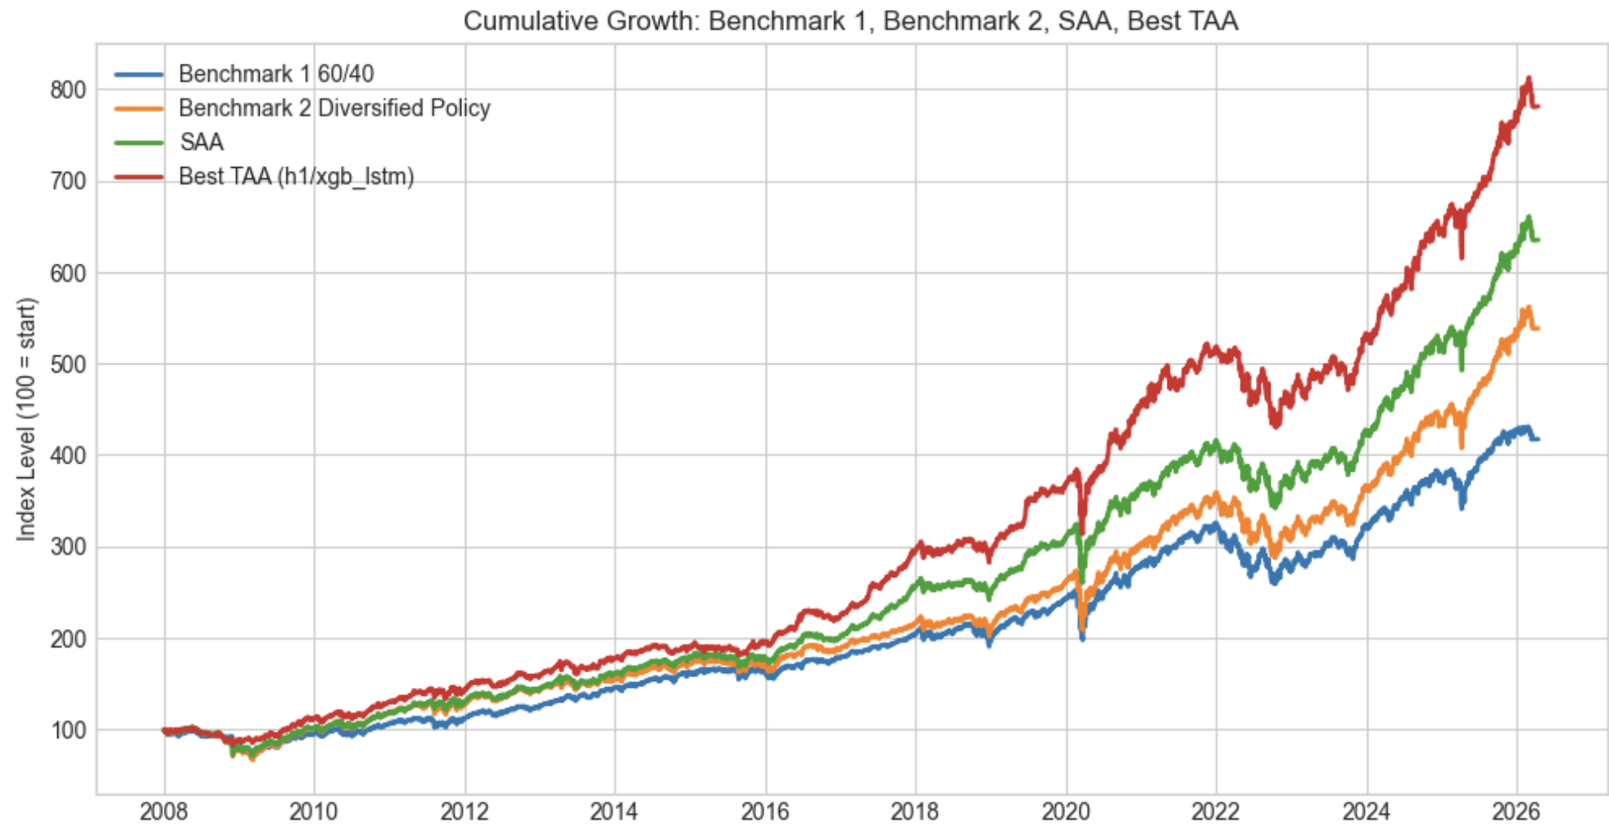
Performance Continued
The TAA portfolio separated most clearly after 2016
The better downside protection during stress periods allowed for stronger compounding
The TAA offered less protection during 2022, when equities and bonds sold off together

Slide 11
SAA vs TAA Contribution
Relative to the diversified benchmark, the SAA improved return from 7.71% to 8.50% and reduced volatility from 11.91% to 10.41%
The SAA added value through a better strategic asset mix and diversification, but still breached the max drawdown constraint
The TAA overlay further improved return to 9.49% and reduced volatility to 9.13%
The TAA significantly reduced max drawdown from -30.54% to -19.05%, making it the only portfolio to satisfy all 3 IPS targets
The SAA created the strategic foundation, while the TAA added downside protection

Slide 12
Recommendations & Limitations
We recommend that Whitmore Capital Partners adopt the SAA as the baseline portfolio with the market stress TAA overlay
The TAA improved return, volatility, and max drawdown, as well as Sharpe and Calmar
The overlay works best when market stress signals deteriorate together, and may struggle with sharp crashes and fast reversals
When the bond equity correlation relationship deteriorates, as in 2022, the TAA offers less protection
The TAA should be treated as a decision support tool, not an automated system

